Slide 1

Network Data Transfer Protocols in IoT & Embedded

Slide 2
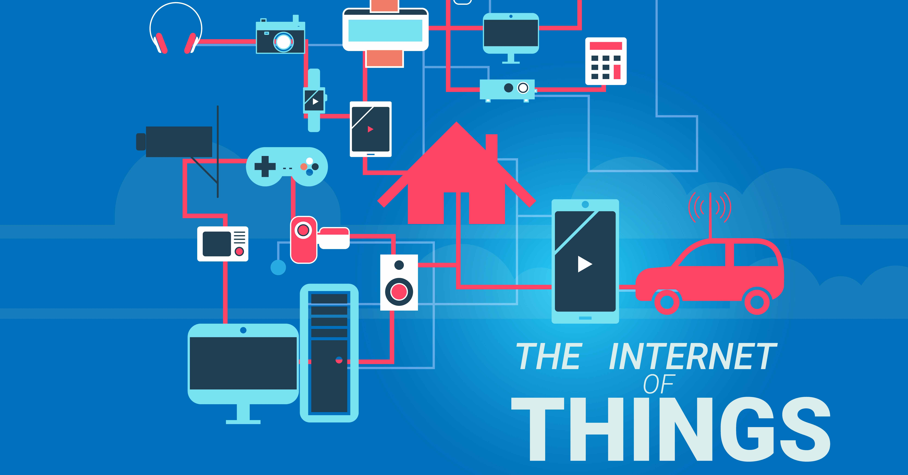
IOT = sensors + data + network + services
Simply put, the Internet of Things is a global network of computers, sensors and actuators that communicate with each other using the Internet Protocol IP (Internet Protocol).

Slide 3
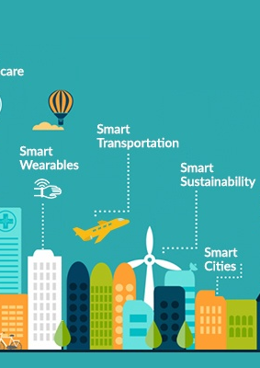
Practical Applications of IoT
“Smart Planet” - a person will be able to literally “keep abreast of the planet”: respond promptly to omissions in farm planning, pollution and other environmental problems, and therefore effectively manage non-renewable resources.
"Smart City" - urban infrastructure and related municipal services, such as education, health, public safety, housing and utilities, will become more connected and effective.
“Smart Home” - the system will recognize specific situations occurring in the house, and respond to them accordingly, which will provide residents with safety, comfort and resource saving.
“Smart Energy” - reliable and high-quality transmission of electrical energy from the source to the receiver will be provided at the right time and in the required amount.
“Smart transport” - moving passengers from one point of space to another will become easier, faster and safer.
“Smart medicine” - doctors and patients will be able to get remote access to expensive medical equipment or electronic medical records anywhere, a system of remote health monitoring will be implemented, the delivery of medicines to patients will be automated, and much more.

Slide 4
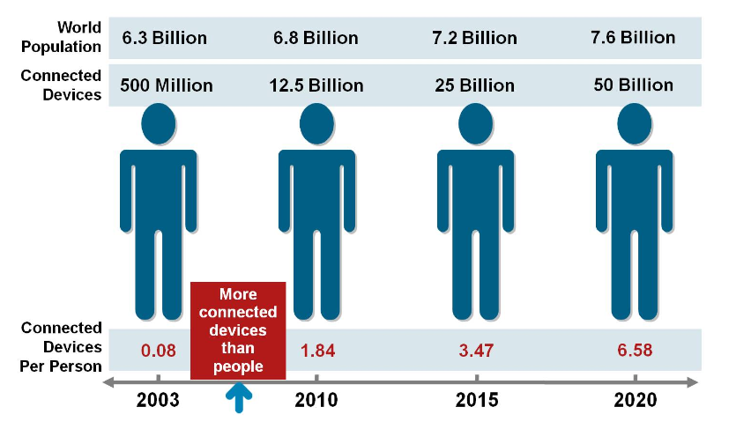
The time scale of the number of people and objects connected to the internet (Source: Cisco IBSG)

Slide 5
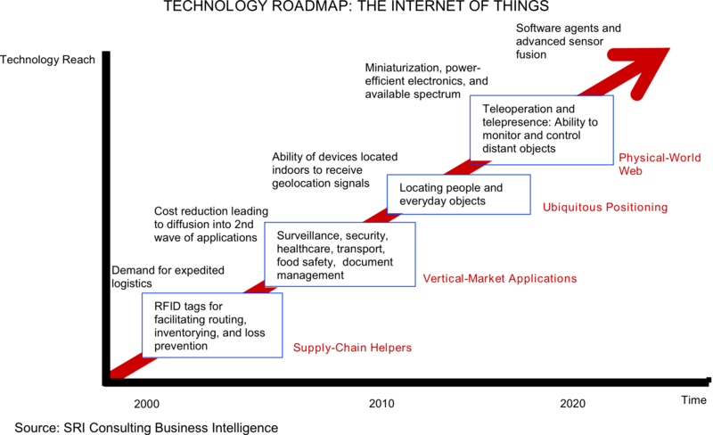
The process of developing the Internet of Things

Slide 6
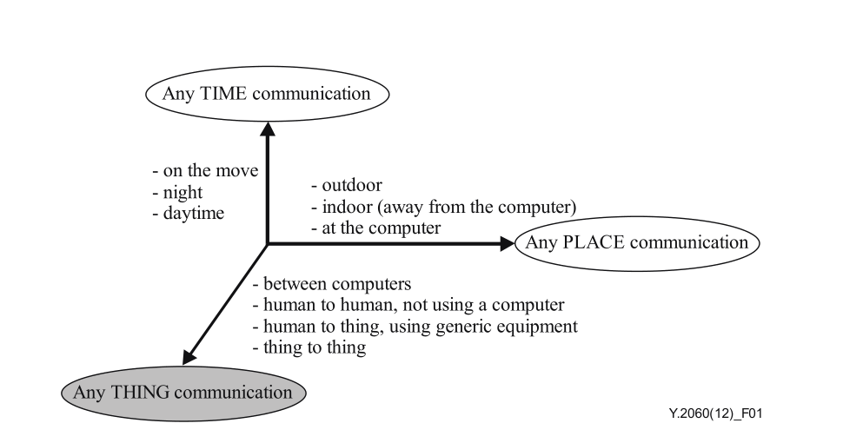
The new dimension introduced in the Internet of things [b-ITU Report]
The Internet of Things is based on three basic principles. Firstly, the ubiquitous communication infrastructure, secondly, the global identification of each object and, thirdly, the ability of each object to send and receive data through the personal network or the Internet to which it is connected.
- focus on things, not people; - significantly larger number of connected objects; - significantly smaller objects and low data transfer rates; - focus on reading information, not on communications; - the need to create new infrastructure and alternative standards.
Notes:
The Internet of Things is based on three basic principles. Firstly, the ubiquitous communication infrastructure, secondly, the global identification of each object and, thirdly, the ability of each object to send and receive data through the personal network or the Internet to which it is connected.
focus on things, not people; significantly larger number of connected objects; significantly smaller objects and low data transfer rates; focus on reading information, not on communications; the need to create new infrastructure and alternative standards.

Slide 7
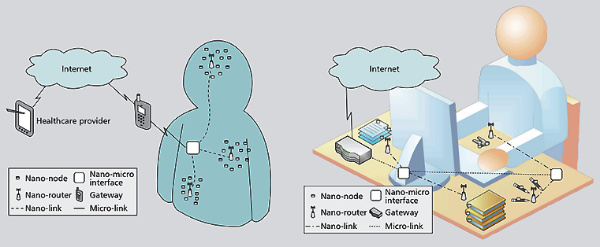
internet architecture nano-things
1. Nano-nodes are miniature and simplest nano-devices. Allow you to perform simple calculations, have limited memory and limited range of signal transmission. Examples of nano-nodes can be biological nano-sensors on the human body or inside it, or nano-devices embedded in everyday things around us - books, watches, keys, etc.
2. Nano-gateways - nano-devices have relatively high performance compared to nano-nodes and perform the function of collecting information from nano-nodes. In addition, nano-gateways can control the behavior of nano-nodes by performing simple commands (on / off, sleep mode, transmit data, etc.).
3. Nano-micro interfaces - devices that collect information from nano-gateways, and transmit it to external networks. These devices include both nano-technologies of communications and traditional technologies for transferring information to existing networks.
4. Gateway - this device monitors the entire nano-network through the Internet. For example, in the case of a network with sensors on the human body, this function can be performed by a mobile phone that transmits information about the required indicators to a medical institution.
https://www.researchgate.net/publication/313523261_Internet_of_Nano_Things_IoNT_Next_Evolutionary_Step_in_Nanotechnology/download

Slide 8
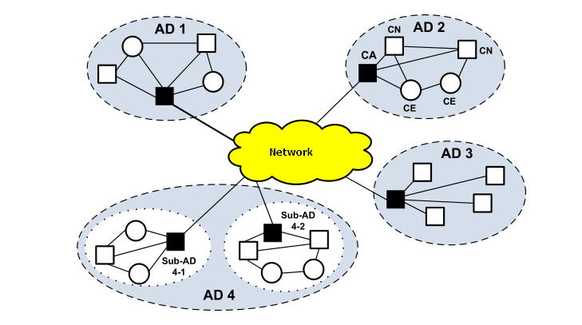
Cognitive Internet of Things
Cognitiveness means that the IoT object has the following general properties:
the ability to self-analyze and reconfigure taking into account the existing environment, as well as having in mind the achievement of goals determined by the tasks performed;
the ability to adapt one's condition according to the existing conditions or events, based on certain criteria and knowledge of previous states;
the ability to dynamically change its topology and / or operational parameters in accordance with the requirements of a particular user, when it is necessary within the framework of the current service policy, optimization of network bandwidth or other indicators;
self-configuration with rule-based distributed control;
the possibility of self-determination of their current state and, given this state, the planning of their work, making certain decisions in response to the current situation.
It seems that in practice, cognitive Internet things will be able to:
use technologies to gain knowledge about their operating and geographical environment, location, using standard positioning technologies;
set independently or use ready-made rules of interaction between objects;
dynamically and autonomously adjust their operational parameters and protocols in accordance with the knowledge gained in order to achieve predetermined
goals, in particular to choose the most appropriate technology of radio transmission;
be trained on the basis of the achieved results using the best practices and the most effective policies to achieve the goals of creating IoT.
https://www.researchgate.net/publication/329070183_Cognitive_Internet_of_Things

Slide 9
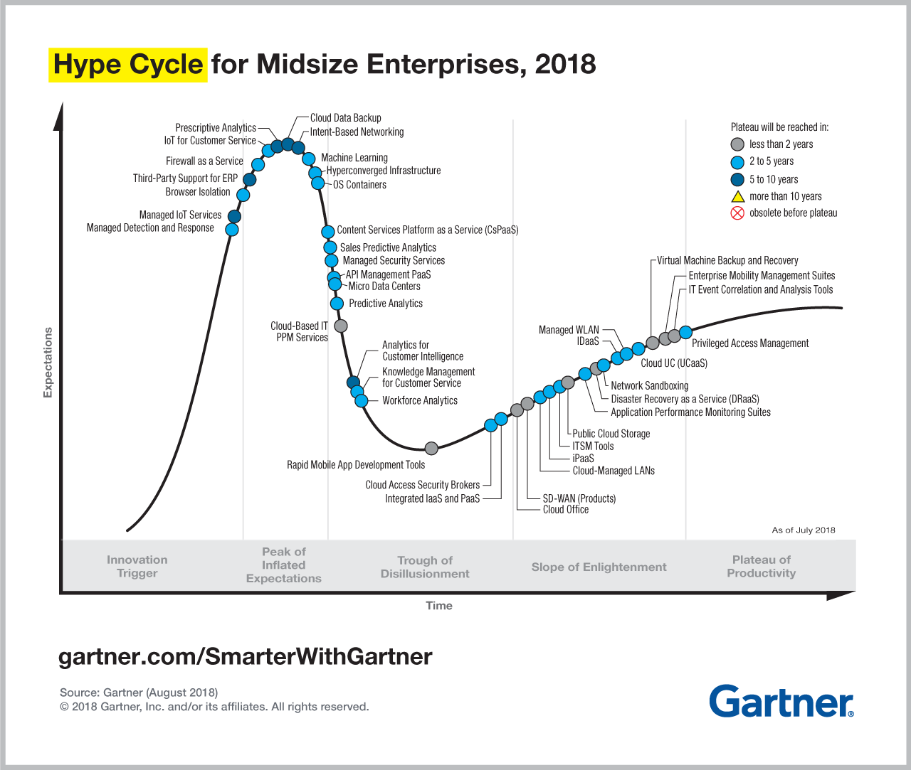
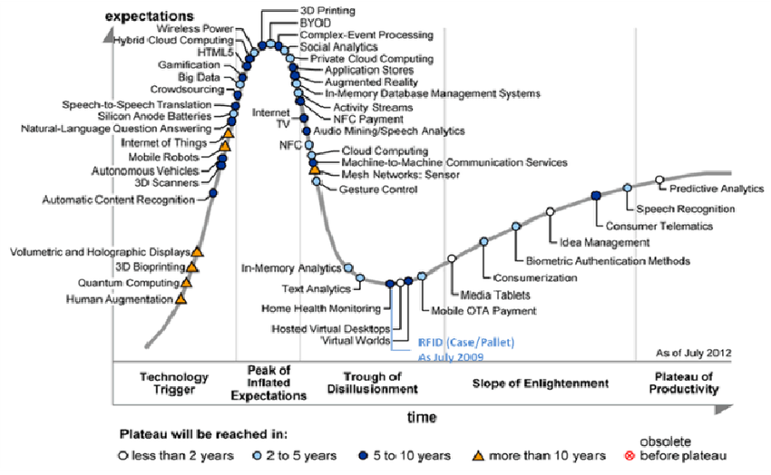
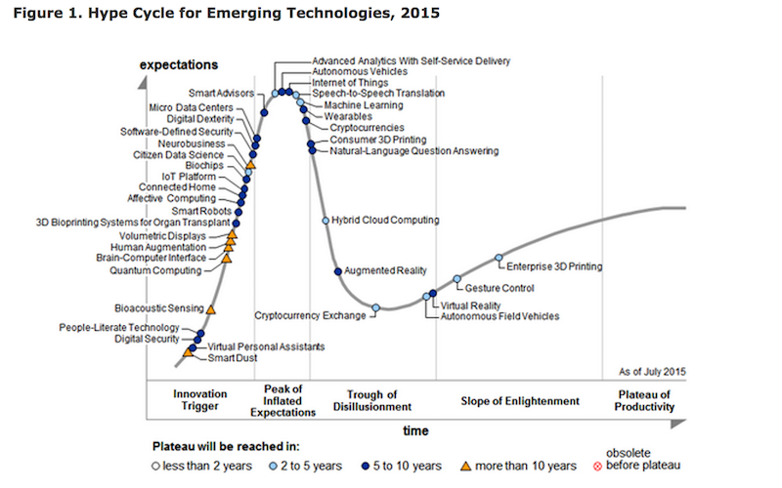
Maturity of the IoT concept and its component technologies
Since 2011, Gartner has placed the Internet of Things in the overall maturity cycle of new technologies at the initial stage of the “technological trigger” indicating the formation period of more than 10 years, and in 2012 a special maturity cycle was released for the technologies that form the basis of IoT

Slide 10
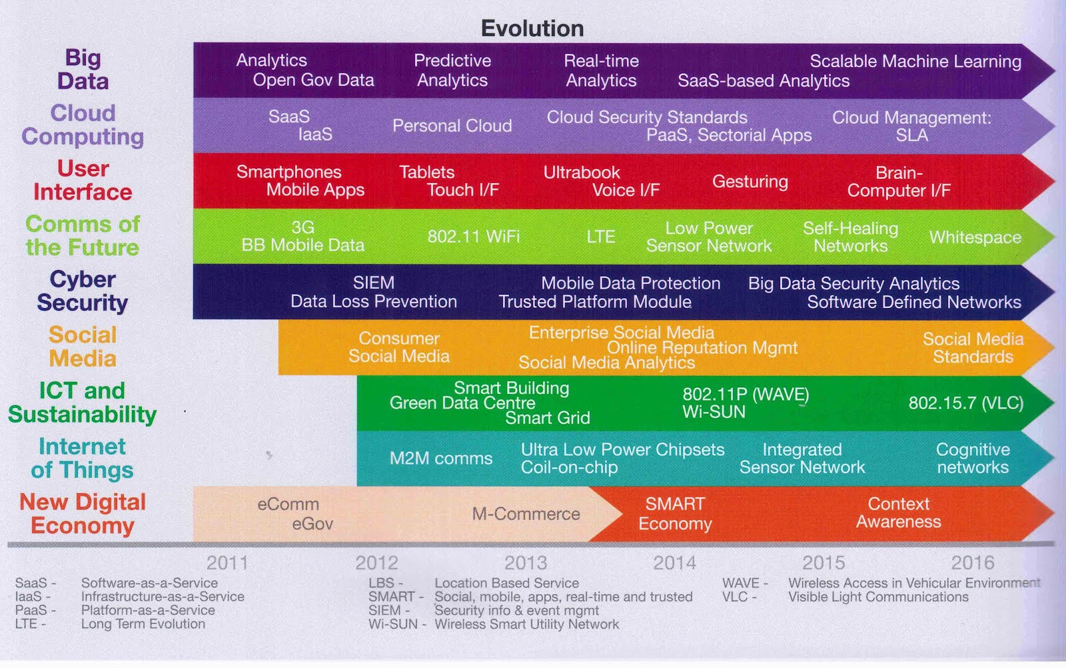
Evolution of the Internet of Things and related information and communication technologies
https://coolerinsights.com/2012/08/mapping-singapores-infocomm-future/

Slide 11
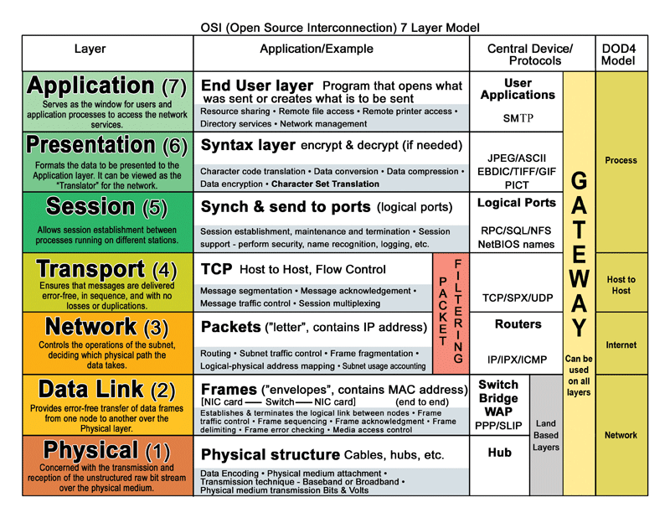
Open source interconnection layer model

Slide 12
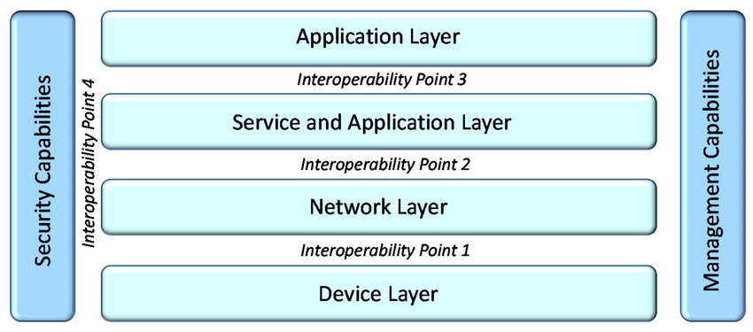
International Telecommunication Union, ITU-t
ITU-T SG20: IoT and its applications including smart cities and communities (SC&C)
Next Generation Networks Global Standards Initiative (NGN-GSI)
ITU-T IPTV Global Standards Initiative
https://www.itu.int/en/ITU-T/studygroups/2017-2020/20/Pages/default.aspx

Slide 13
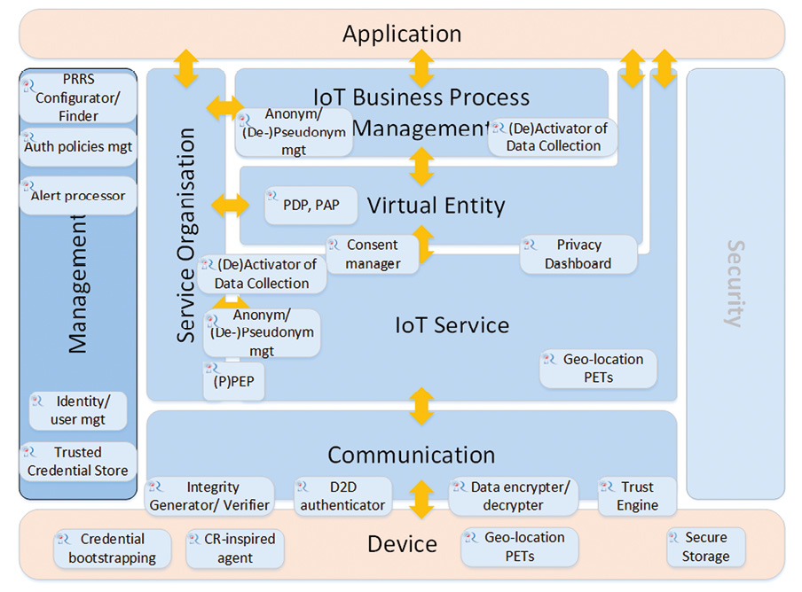
IoT-A Internet of Things – Architecture
The main goal of the European integration project IoT-A (Internet of Things - Architecture), which involves various companies, is to develop a reference architectural model of the Internet of things with a description of the main components that would allow integrating heterogeneous IoT technologies into a single interconnected architecture.
http://cocoa.ethz.ch/downloads/2014/01/1360_D1%202_Initial_architectural_reference_model_for_IoT.pdf

Slide 14
Types of Wireless Networks
Type of Network | Coverage Area | Function | Cost | Data Rate | Standards
WLAN | In buildings or campuses; typically 100 meters | Mobile extension of wired networks | Low-Medi um | 1-100 Mbps | 802.11a, b,g,n, Wi-Fi and HiperLAN/2
WPAN | within reach of a person, typically 10meters | Cable Replacement Technology, personal networks | Very Low | 0.1-4 Mbps | IrDA, Bluetooth, 802.15
WMAN | Within a city | Fixed Wireless between homes and businesses and the Internet | Medium- High | 134 Mbps | IEEE 802.16 and WIMAX
WWAN | Coverage provided on national basis from multiple carriers, | Mobile access to the Internet from outdoor areas | Medium- High | 8 Kbps-2 Mbps | GSM,TDMA, CDMA,GPRS,EDG E,WCDMA

Slide 15
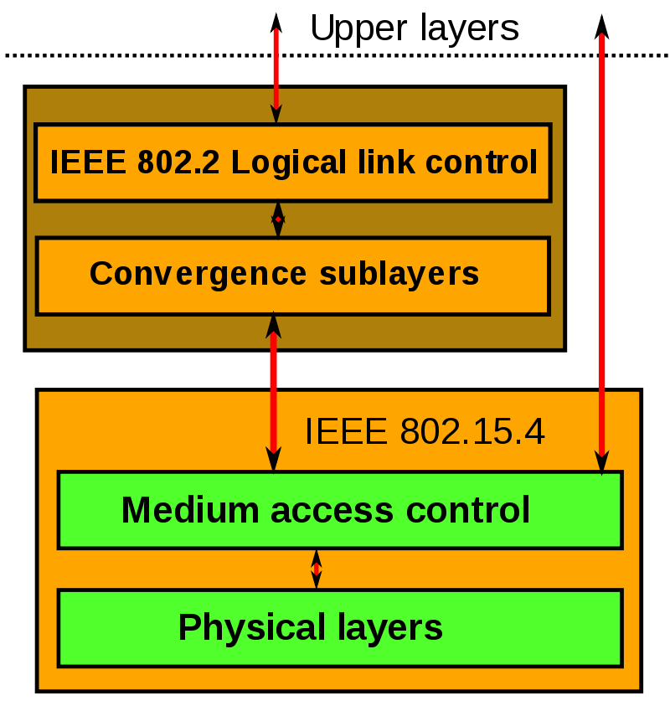
PERSONAL AREA NETWORK
• Used to interconnect portable computers and/or devices like peripherals and sensors
• These devices may be carried or worn by a person and/or may be located nearby Home/Office computers, printers, phones, LANs, GPS or other car resources can be connected as needed. Two or more devices communicate on the same physical channel.
• May include at one FFD that operates as the PAN coordinator.
• The PAN coordinator initiates, terminates, or routes communication around the network. The PAN coordinator is the primary controller of the PAN.
• The WPAN may operate in either of two topologies: the star topology or the peer-to-peer topology.
Devices are conceived to interact with each other over a conceptually simple wireless network. The definition of the network layers is based on the OSI model; although only the lower layers are defined in the standard, interaction with upper layers is intended, possibly using an IEEE 802.2 logical link control sublayer accessing the MAC through a convergence sublayer. Implementations may rely on external devices or be purely embedded, self-functioning devices.

Slide 16
802.15.4 Technology: General Characteristics
Data rates from 20 kb/s (868 MHz) to 250 kb/s (2450 MHz)
ultra-wideband (UWB) and another using chirp spread spectrum (CSS). The UWB PHY is allocated frequencies in three ranges: below 1 GHz, between 3 and 5 GHz, and between 6 and 10 GHz. The CSS PHY is allocated spectrum in the 2450 MHz ISM band
Star or peer-to-peer operation
Allocated 16 bit short or 64 bit extended addresses
Multi-month to multi-year battery life
16 channels in the 2450 MHz band, 10 channels in the 915 MHz band, and 1 channel in the 868 MHz band (European)
Channel Access is via Carrier Sense Multiple Access with collision avoidance and optional time slotting
Message acknowledgement and an optional beacon structure - these are periodic broadcast messages of the access point (for example, every 100 ms). Frames inform clients about the presence of an access point and carry system parameters such as ID, time, interval to the next beacon, and security settings.

Slide 17
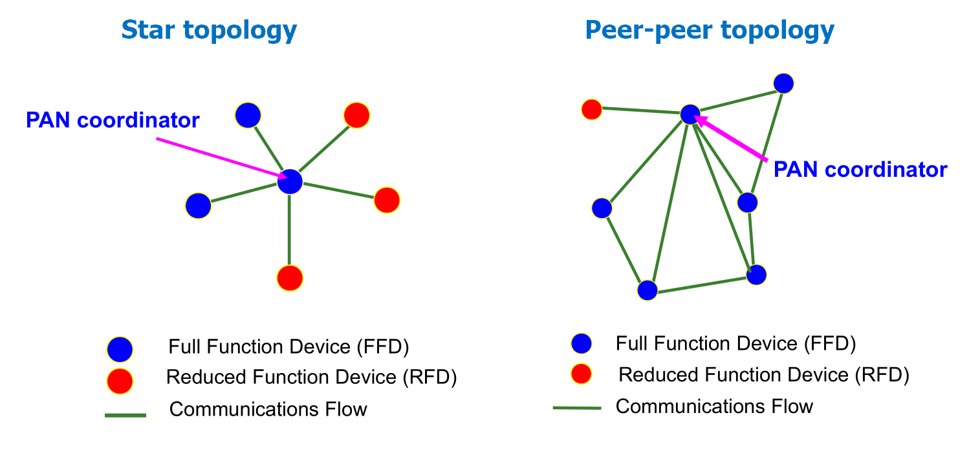
IEEE 802.15.4 Device Types
There are two different device types :
A full function device (FFD)
A reduced function device (RFD)
The FFD can operate in modes serving:
Device
Coordinator (PAN coordinator)
The RFD can only operate in a mode serving:
Device
Full function device (FFD) properties:
Network coordinator capable
Talks to any other device
Reduced function device (RFD) properties:
Cannot become a network coordinator
Talks only to a FFD
Very simple implementation

Slide 18

ZigBee technology
low-power, wirelessly networked, monitoring and control
Products based on an open global standard
45+ companies: Texas Instruments, Motorola, Philips, IBM, Ember, Samsung, NEC, Freescale Semiconductor, LG, OKI, etc.
Defining upper layers of protocol stack: from network to
Application, including application profiles
First profiles published mid 2003
Low power consumption
Low cost
Low offered message throughput
Supports large network orders (<= 65k nodes)
Low to no QoS guarantees
Flexible protocol design suitable for many applications

Slide 19
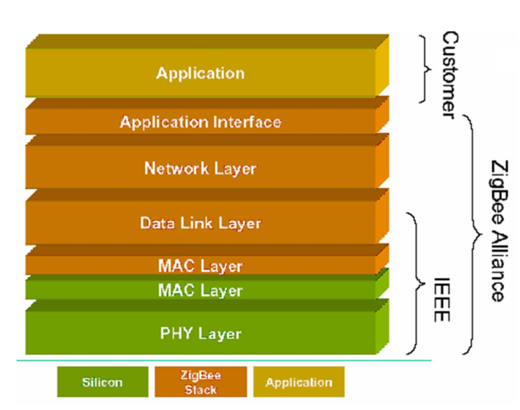
Zigbee protocol stack
Lower (MAC/PHY) stacks IEEE 802.15.4
Upper stacks Zigbee Alliance
IEEE 802 compatible LLC protocol can be used
At the network level, ZigBee defines the routing mechanisms and the formation of the logical network topology.
The ZigBee standard supports a network with a cluster architecture formed from ordinary nodes clustered by routers. cluster routers requesting sensor data from the devices and relaying them to each other, transmit the coordinator, which normally has a connection to an external IP-network, and which sends information storage and final processing.
The ZigBee network is self-organizing, that is, all nodes are able to independently determine and adjust the data delivery routes.

Slide 20
Comparing characteristics of the Wireless Personal Area Networks
 | ZigBee (IEEE 802.15.4) | WiFi (IEEE 802.11b) | Bluetooth (IEEE 802.15.1)
Frequency range | 2.4-2.483 GHz | 2.4-2.483 GHz | 2.4-2.483 GHz
Bandwidth, kbps | 250 | 11000 | 7131.1
The size of the protocol stack, KB | 32-36 | >1000 | >250
Continuous battery life, days | 100 – 1000 | 0.5 – 5 | 1 – 10
Maximum number of nodes in the network | 65536 | 10 | 7
Range of action, m | 10 – 100 | 20 – 300 | 10 – 100
Application areas | Remote monitoring and control | The transfer of multimedia information | Wire Substitution

